Slide 1
EGit
Paramasivam. K
Git.. Git.. Git.aAAAAAA

Slide 2
VCS – Route Map
Why VCS
What is VCS
Type of VCS
Local VCS
Server based VCS - easy administration
Distributed VCS – every green

Slide 3
Different Version Control
Rcs – first local VCS
CVS – old since 80's – Server based
SVN – apache – Server based
Git / libGit2 / Jgit – distributed – fast – best for single developer
Mercury – distributed – best for single developer - python
PVCS – commercial
ClearCase – Commercial – IBM – Rational tool
Perforce
Visual Source safe

Slide 4
Who am i

Slide 5
no..no..no
What is Egit - > Jgit – Git
Why Egit
Repository
Command line interface
Eclipse Plugin as interface.
Egit is going to work with Jgit as well as Git

Slide 6
Git – Started Date
In 2002, by linux kernal community based on BitKeeper – Distributed VCS.
In 2005, Linus started – Git – after quarrel
Its repository can be local, centralized, distributed
Server repository called as “bare repo.”.

Slide 7
GIT - Definition
Series of commits
Logic name for set of commits is called BRANCH
Tip of currently checked out branch is HEAD.
A reference name for a particular commit is called TAG.
Working directory can have many folders. They are just folder as per GIT, But with respect to Egit each folder may be a java project.
Repo. Is consist of working directory and .git meta folder.
Working directory is optional
Local branch may have more commit than remote commit. Since when i decide only that commit i am going to share.

Slide 8
Git – Concept and Idea
Repository / Object Type / SHA 1
Blob – store only content
Tree - store file name, mode, blob reference, other tree
Index
Branches ( Local & Remote Tracking )
Working Direcoty / Working Tree
Untracked & tracked ( Unmodified/modifed/staged )
Repository = Working directory + meta directory

Slide 9
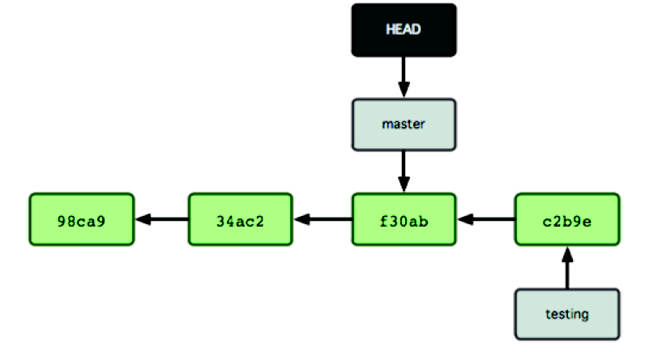
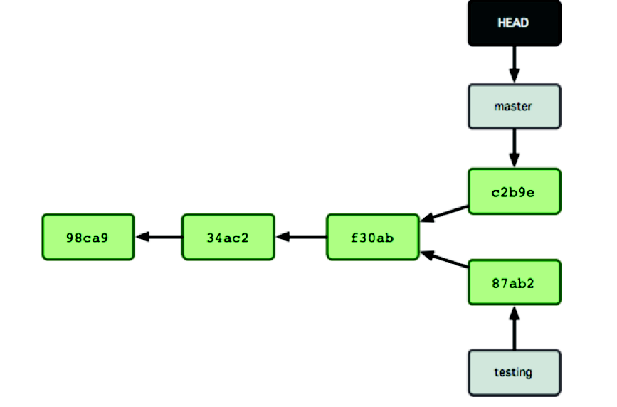
Repository Bone Taste

Slide 10
Key files and directories
.gitignore
/etc/gitconfig - first read file, global file for all user.
/.gitconfig – user specific file, global to all repo.
.git/config – specific to a repo.
.git/info/attributes – to configure attributes
.gitattributes
.git/object
.git/index
.gitmodules

Slide 11
Proper Noun

Slide 12
4.1 Noun – are same in all version control
HEAD, FETCH_HEAD, ORIGIN_HEAD, NO-HEAD
Branch / Merging / Reset / Rebase / Cherry-Pick
Tag – specify a reference to a particular commit, where as a branch, may have more than one commit and latest commit pointed by HEAD.
Patch
Managing Repository / clone – remote repo.
Reset Types
Index
Icon descriptions

Slide 13
4.2 Noun – are same in all version control
Conflict
Local & Remote Repository
Team Project Sets
Commit ( Revision ), Stage
History & Commit
Synchronize among branches
Reflog & RefSpecs
URLs & Protocol
Fast – Forward ( Reachable commit )
3 -way merge ( not reachable commit )
Merge with Conflict

Slide 14
CriKET, Chess, etc.

Slide 15
5.1 Action on EGit
Configure user details
Create local & bare repository
Cloning repository
Adding Projects/ Files.
Modify files, Staging and Commiting
Reverting changes by comparison & Reset
Branching, Mergeing, Rebase & Cherry pick

Slide 16
5.2 Action on EGit
Creating & applying patches on a commit
Tags – create / delete/ push / checkout
Fetch, Pull & Push
Synchronize
History View – Reviewing
Ammend a commit
Repository view – working on it.
Clean repo.
Recovery missed /removed commit from Reflog

Slide 17
5.3 Action on EGit
Stash
Merge by simply FAST-FOWARD
Merge by 3-WAY by introduce new commit automatically
Merge by conflict – when same part of same file is different among two branches- need to resolve, stage, commit
Do Rebase – to have clean repos.

Slide 18
Possible of sub-product

Slide 19
Possible of item to cook from a commit wheate
Create Branch
Create Tag
Create Patch
Create Cherry-Pick
Do Merge
Do Rebase

Slide 20
Different Eye Glass

Slide 21
Food items on the table
Repository view
History Views
Commiter view
GitLog view
Synchornizing view
Stage view
Git Tree compare – input not a file for history view
Git Search Dialog
Open a Commit Dialog
Blame

Slide 22
Start the Game

Slide 23
Extra Rice
Easy to integrate with Mylyn – Task viewer
Easy to integrate with Gerrit – Code review
Easy to extend myself to do the task of JACL script in WAS environment. Since Jgit is java library
If i want to customize, let me get Jgit library and change the java code as per my need.

Slide 24
First user
Create a java project
Create a local repo. And share that project
Add project to index then commit
Push project to remote repo.
I guess, i create a bare repo. In share drive
Push my local repo. To bare repo. Other developer can fetch it from there.

Slide 25
Second user [ work flow ]
Clone the remote repository to local file system from repo. View
Then import project from local cloned repo.
[Do in Repeat ]
Fetch the changes from remote
Create a local branch usually [topic]
After complete and test, merge local topic with local master branch.
Fetch remote master then merge with local master
Push change to server
Deleter local [topic] branch
[ repeat]

Slide 26
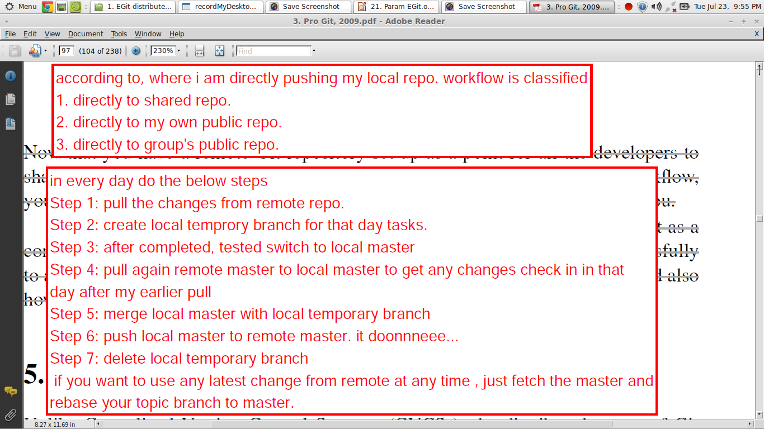
Daily ..

Slide 27
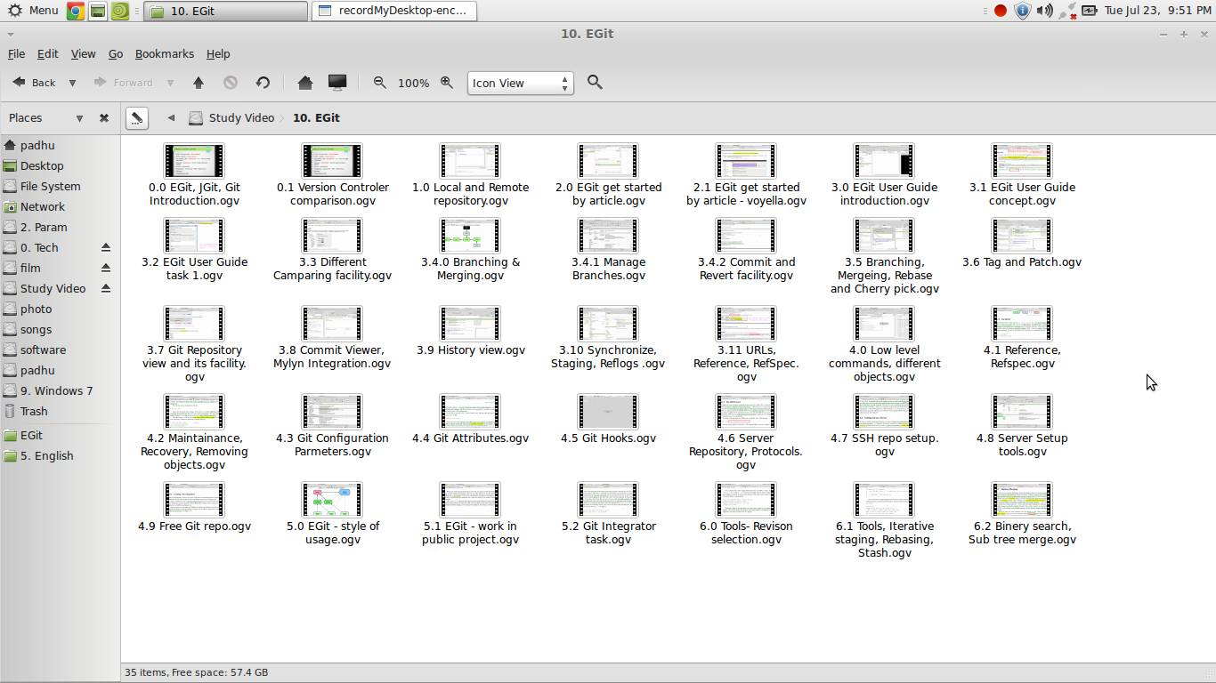
Video Resource

Slide 28
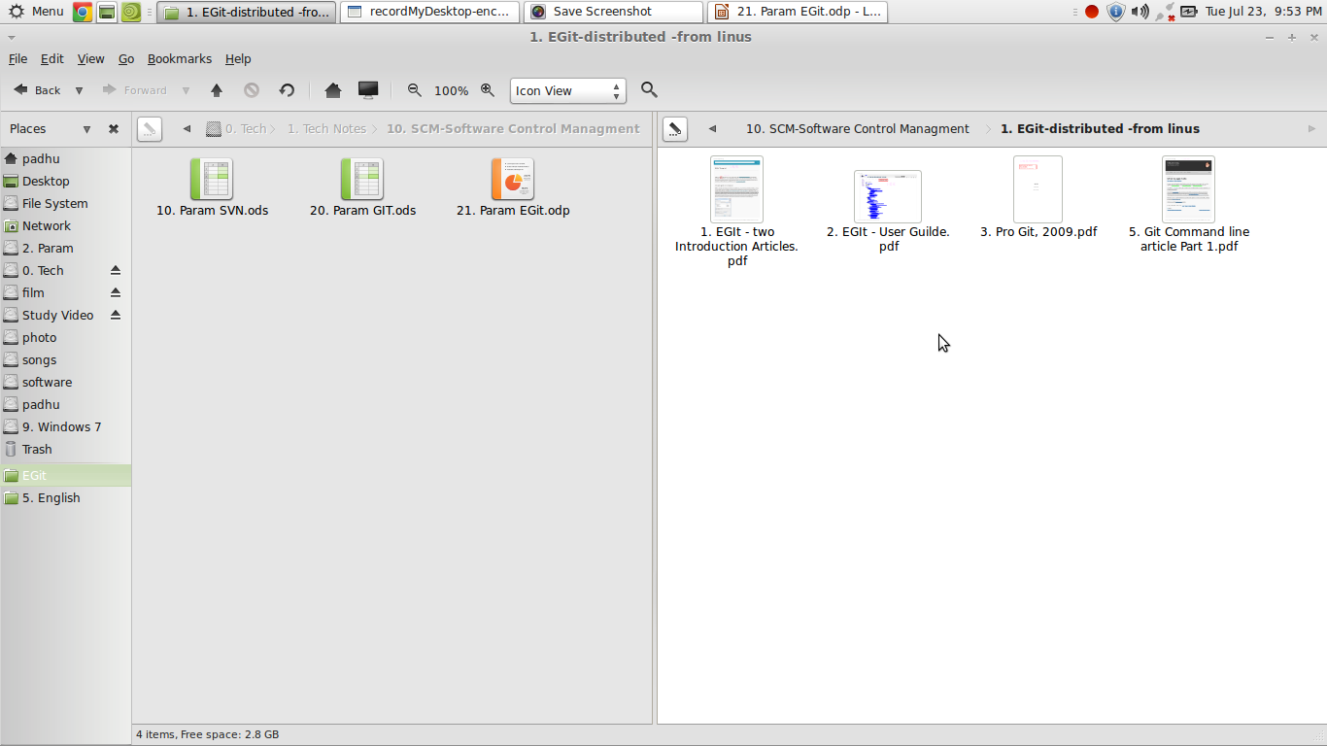
Text Resource

Slide 29
Its Over !!!!!!!

